Slide 1
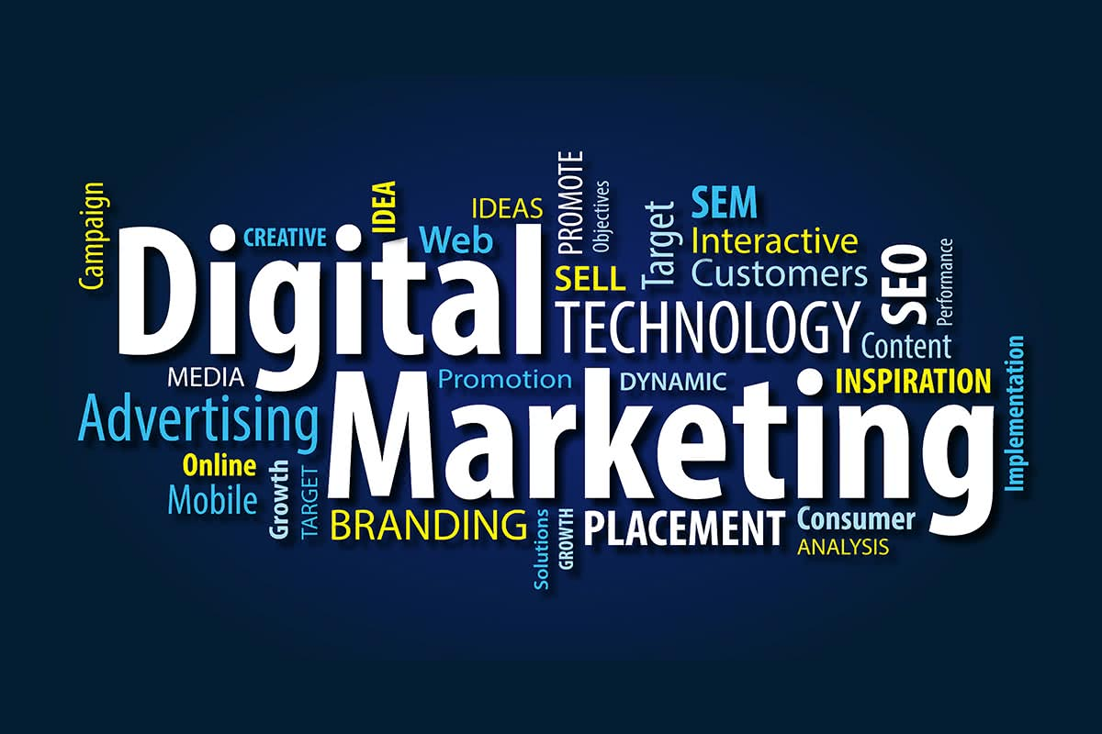

Slide 2
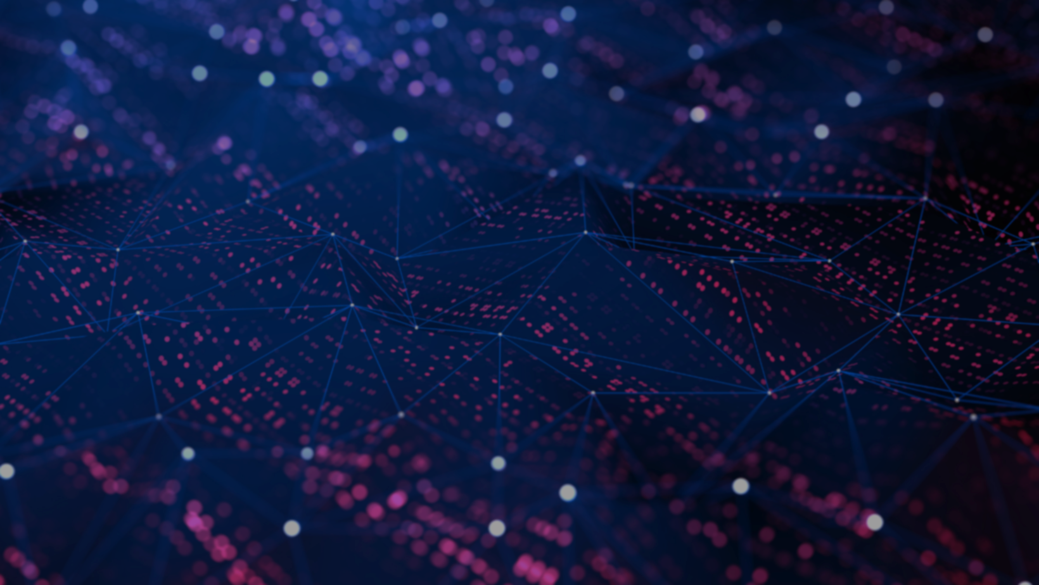

Hello Gentlemen’s and Gentlewomen’s Welcome to
SEO INFLUENCERS

Slide 3
GROUP MEMBERS
SUBIKSHA.K
24PCC825
MAHESH.T
24PCC814
GANESH.S
24PCC827
PRATHISHA.M
24PCC819
MANIVEL.S
24PCC841
SRI BAGYALAKSHMI.K
24PCC848
KISHORE.M
24PCC846
ASWIN HYDEN.R
24PCC845

Slide 4

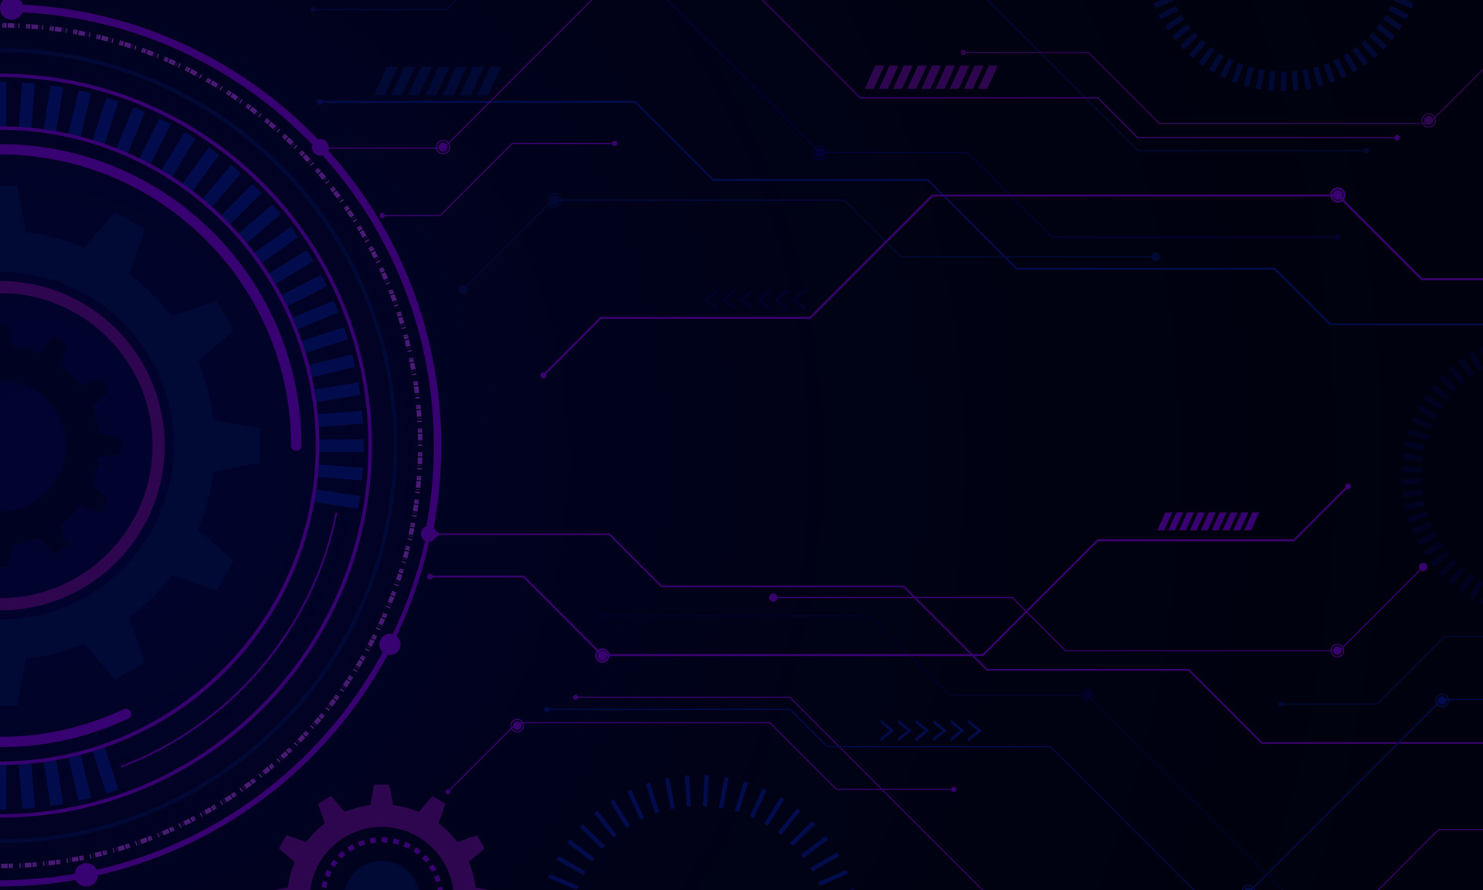
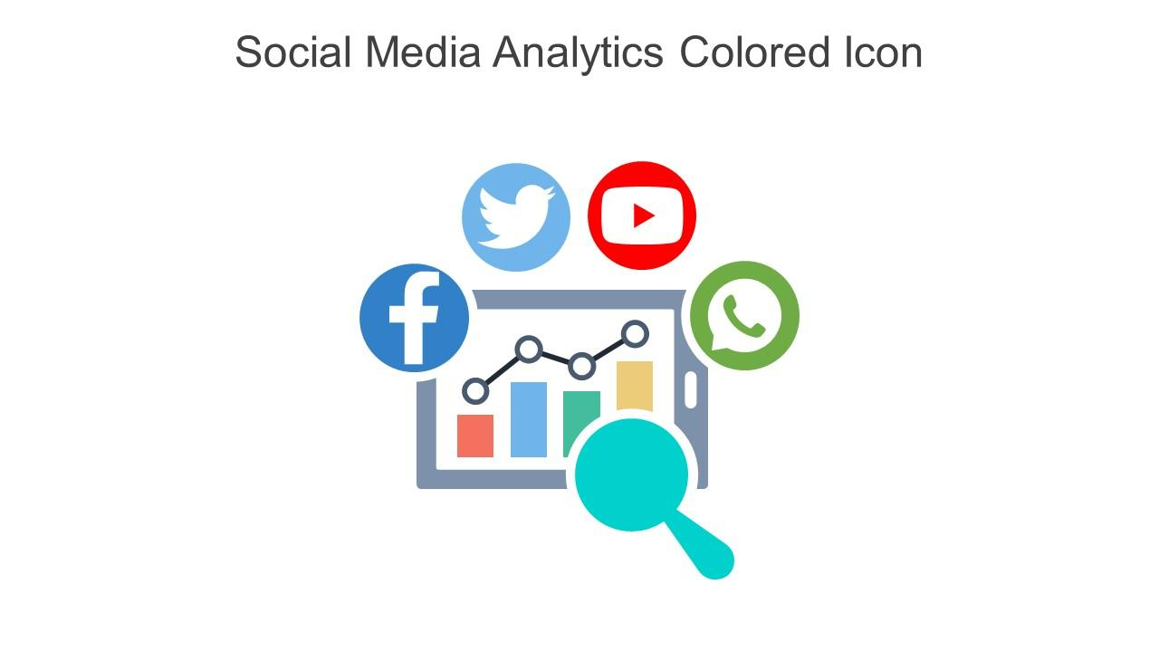
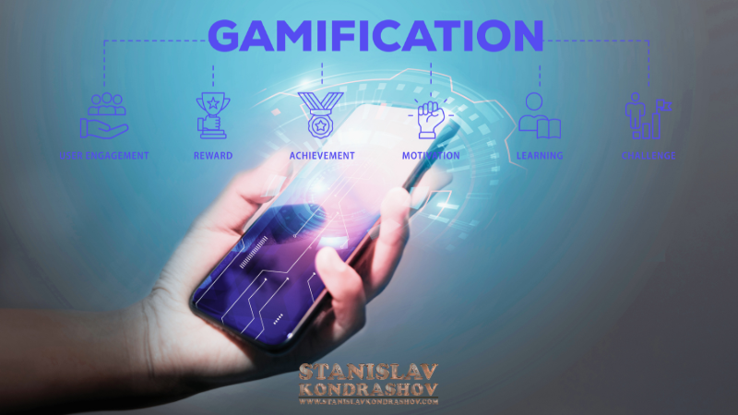
ANALYTICS AND GAMIFICATION
ANALYTICS :
Digital analytics refers to the process of measuring data from channels like websites, email, social media and more to gain an understanding of customer behavior, user experience, and business impact.
GAMIFICATION :
Gamification is the process of incorporating a branded game into your marketing strategy. In order to gamify your brand, your game will need to have fun tasks, clear goals, a simple user interface that's easy to learn and play, and tangible rewards.

Slide 5
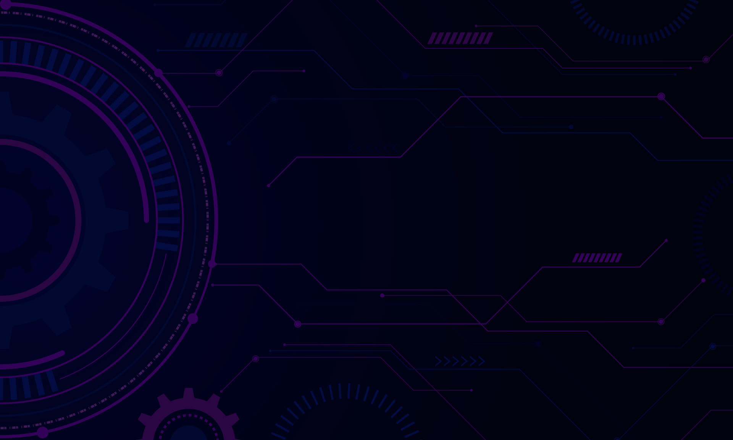
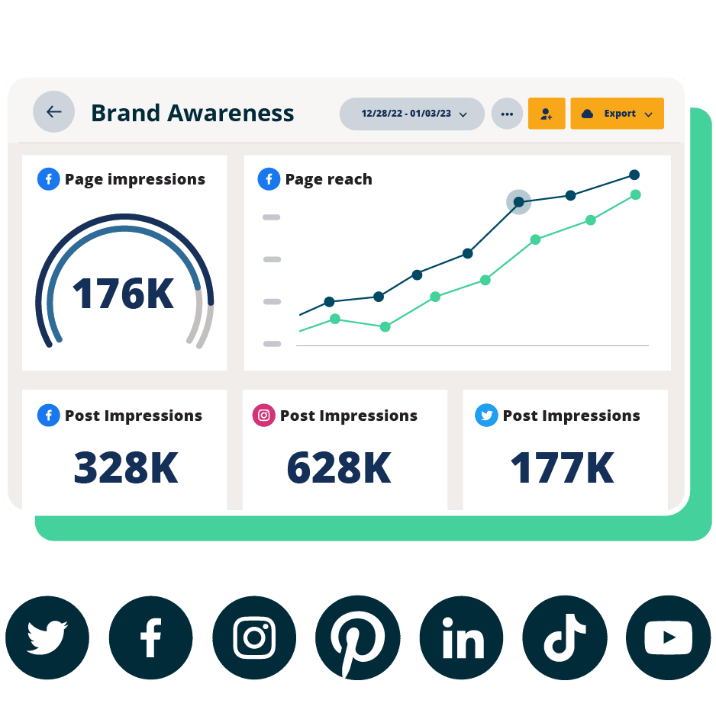
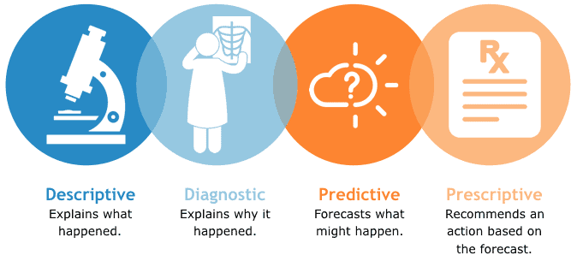
DIGITAL ANALYTICS :
Digital analytics are quantitative measurements of the performance of online content, social media, page reach , page impressions , post impressions and websites.
4 TYPES OF DIGITAL ANALYTICS

Slide 6
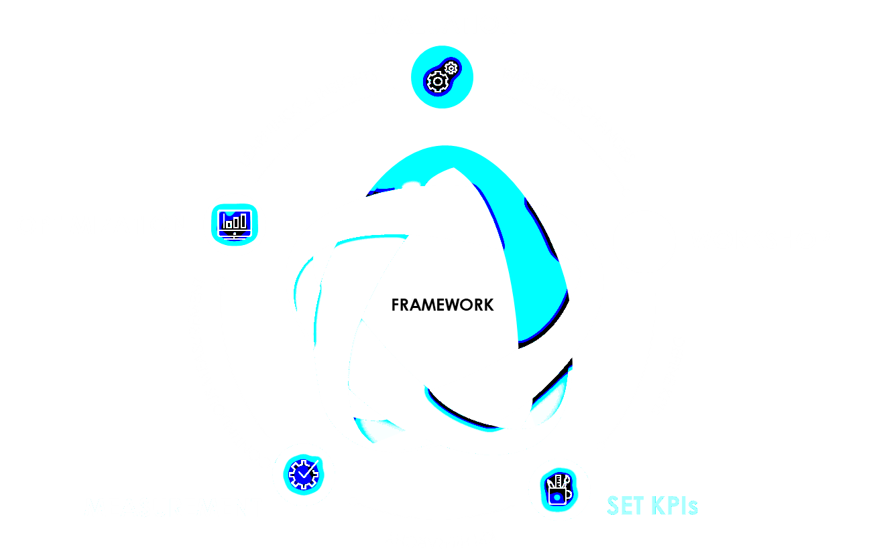
What is a Measurement Framework?
A marketing measurement framework is a structured approach that combines strategies and tools to measure key marketing activities
Measurement frameworks vary in design and approach, but the key aspect is their adaptability.
A measurement framework is a structured way to define your company’s:
Overarching mission or Vision
Business and marketing objectives
Primary KPIs
Secondary metrics
Segmentation

Slide 7
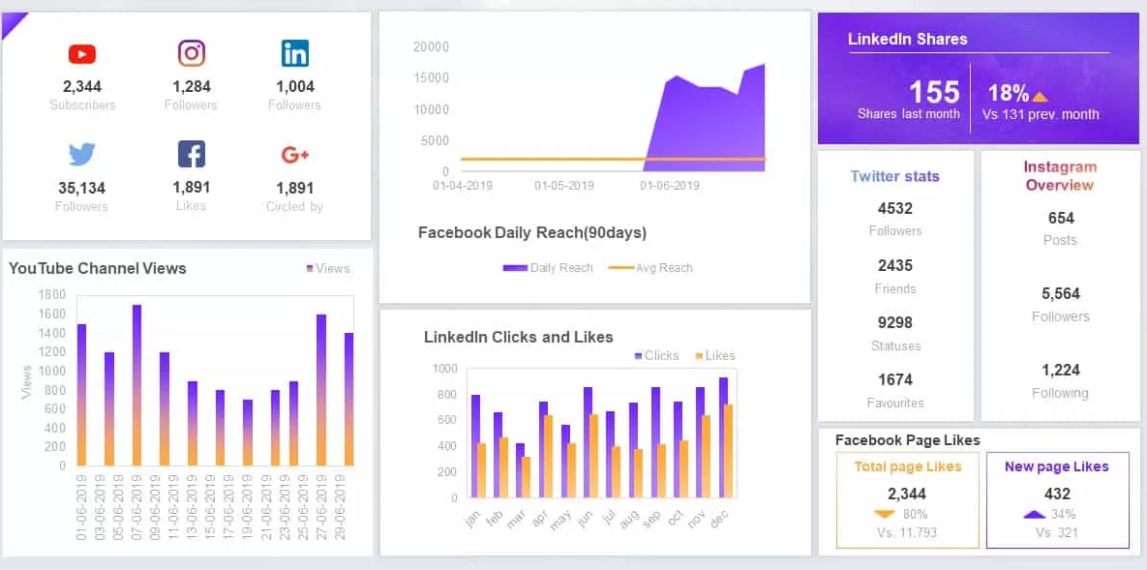
Profile impressions
Profile reach
Followers
Audience growth rate
Engagement rate
Video views
Posting frequency
Clicks
Saves
OWNED SOCIAL METRICS:
Owned social metrics are metrics related to the social channels that a company maintains, such as Facebook, Twitter, or YouTube.
These metrics can help companies understand how their content is resonating with their audience and how visible their brand is on social media
The best social media analytics tools for 2024
1. Hootsuite
2. Sprout Social
3. Buffer
4. Hub spot
5. Later

Slide 8
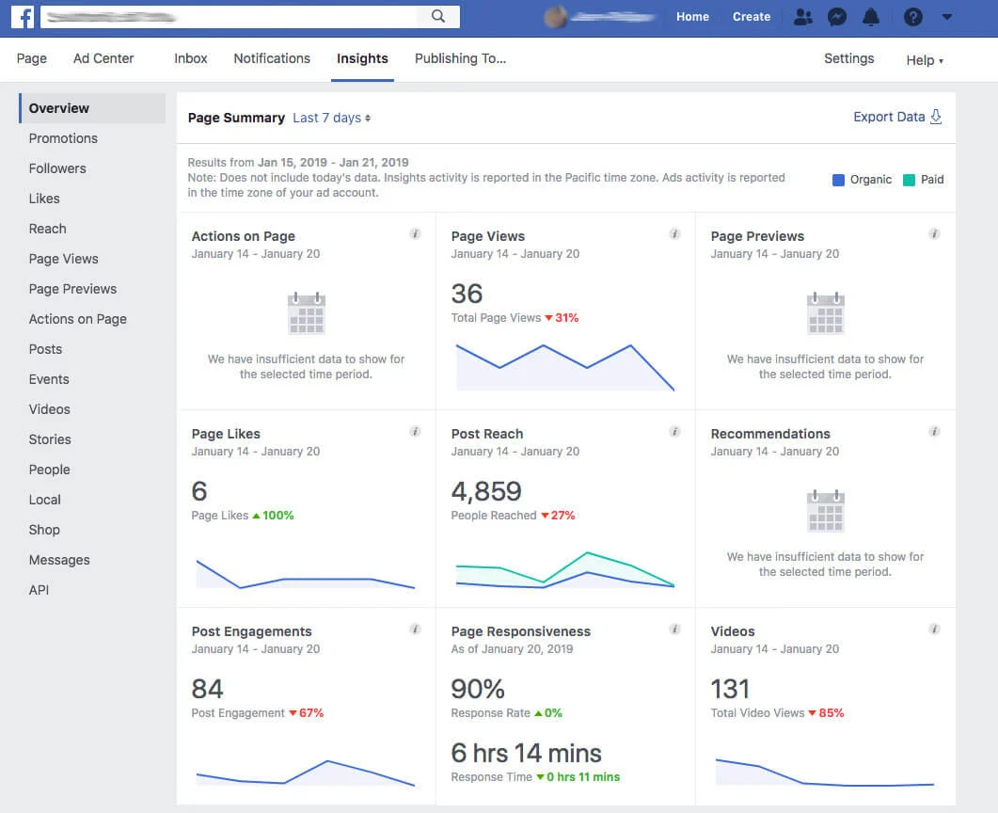

MEASUREMENT METRICS OF SOCIAL MEDIAS
To measure metrics across social media platforms, you'll typically look at several key performance indicators (KPIs) for each:
FACEBOOK :
Engagement Rate
Reach and Impressions
Click-Through Rate (CTR)
Page Likes and Follows

Slide 9

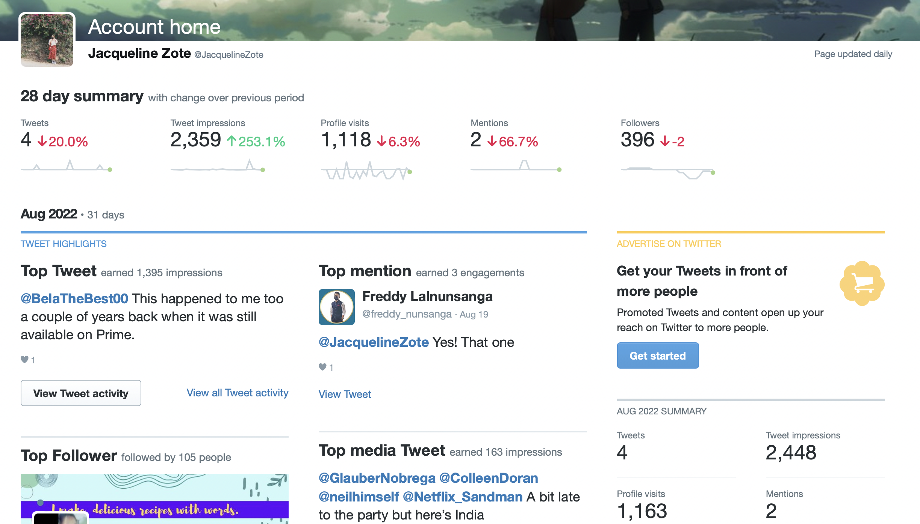
TWITTER-(X):
Engagement Rate
Tweet Impressions
Profile visits
Mentions
Follower Growth

Slide 10

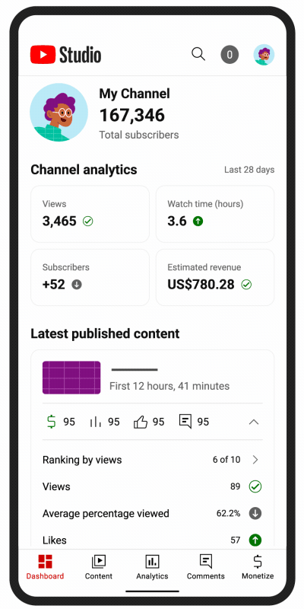
APP NAME – YT STUDIO
YOUTUBE:
Views:
The number of times your video has been watched.
Watch Time:
Total minutes users spend watching your video.
Engagement:
Likes, dislikes, comments, and shares.-
Subscribers:
Growth in the number of channel subscribers.

Slide 11

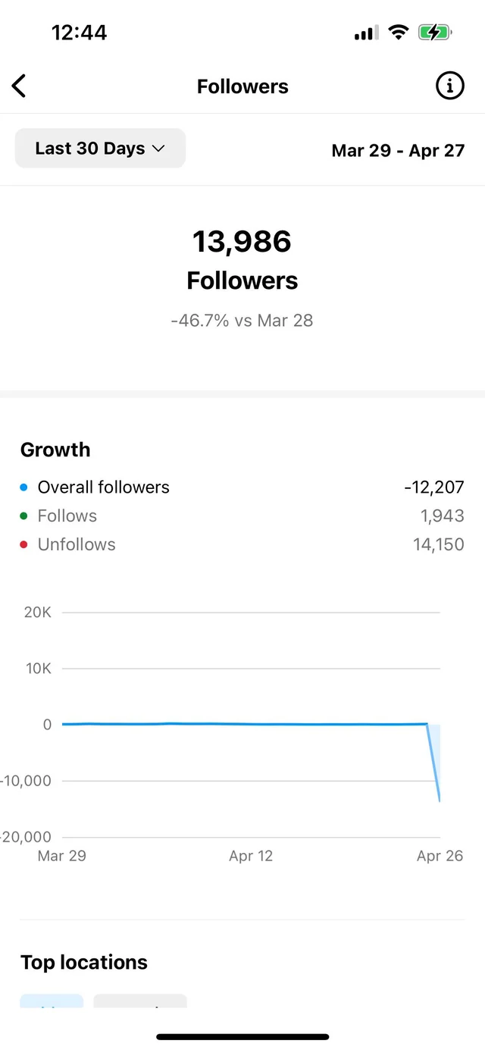
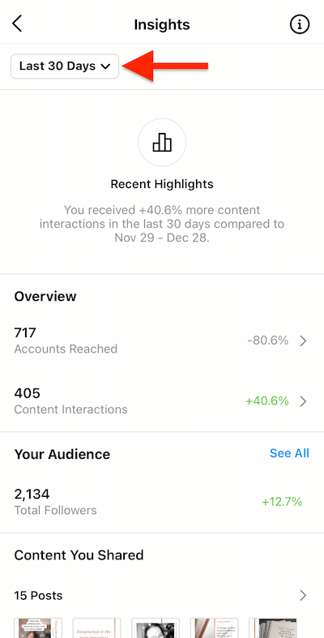
INSTAGRAM:
Engagement Rate:
Likes, comments, shares, and saves per post.
Reach and Impressions:
Unique users who see your posts and total views.
Story Metrics:
Views, replies, and exits for Instagram Stories.
Follower Growth:
Changes in the number of followers over time.

Slide 12
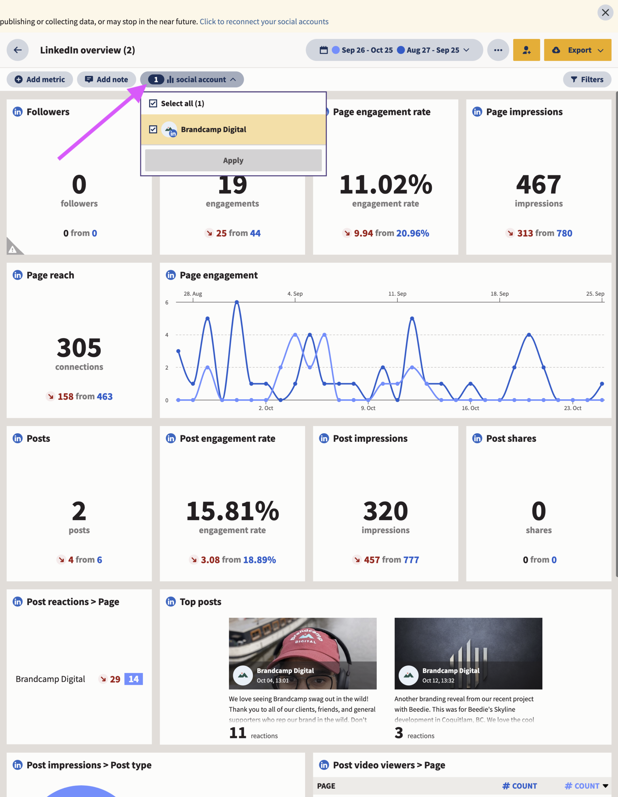

LINKED IN
LinkedIn is professional networking platform for recruitment.
Benefits:
Networking Opportunities
Job Opportunities
Personal Branding
Industry News
Learning & Development
Components:
Profile
Connections
Content Sharing
Groups
Jobs
Messages

Slide 13
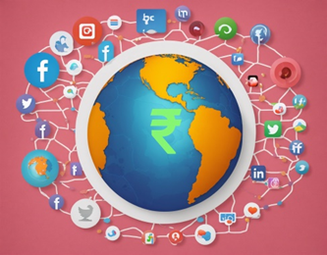
EARNED SOCIAL MEDIA METRICS
Social Media:
Social media refers to the means of interactions among people in which they create, share, and/or exchange information and ideas in virtual communities and networks.
Earned Social Media Metrics:
Earned social media metrics are the data points that reflect the organic reach and engagement of your content on social media.
Benefits:
Authentic Engagement
Brand Awareness
Customer Insights
Cost-Effective
Components:
Shares
Likes
Comments
Mentions
User-Generated Content

Slide 14

DIGITAL BRAND ANALYSIS
Digital brand:
Digital branding is the way your company presents itself to your market and includes your online image, voice, tone, language, and customer perception.
Digital brand analysis:
Digital brand analysis involves evaluating a brand’s presence, performance, and reputation across digital channels.
This analysis helps understand how the brand is perceived online and identifies areas for improvement
Benefits:
Brand Health Assessment
Competitive Analysis
Strategy Development
Customer Insights
Performance Tracking
Components:
Website Analytics
Social Media Metrics
Online Reviews & Ratings
Content Performance
Brand Mentions

Slide 15
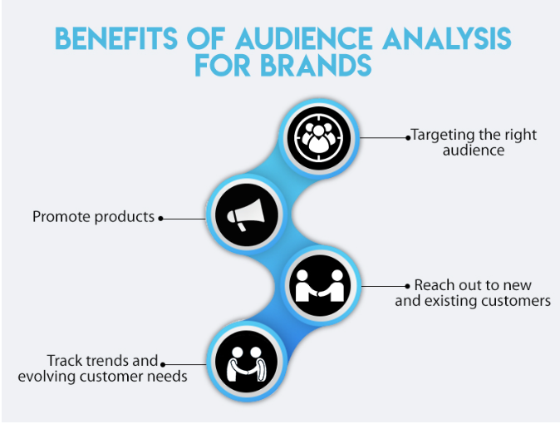
BRAND AUDIENCE DIMENSIONS
In digital marketing, "brand audience dimensions" are used to segment and target specific groups of users more effectively.
Demographic:
Age, Gender
Income
Education
Occupation
Geographic:
Location-Based Targeting
Local Trends and Preferences
Psychographic:
Interests and Hobbies
Values and Lifestyle
Technographic:
Device and Platform Usage Usage and Preferences

Slide 16
MARKET INFLUENCE ANALYTICS
Market Influence Analytics involves using data and analytics tools to understand how various factors influence the performance of digital marketing strategies and campaigns.
Channel Performance:
Attribution: Assess contribution of digital channels (e.g., social, email, search).
Consumer Behavior:
Website: Analyze page views, session duration, bounce rate.
Engagement: Measure social media and email campaign performance.
Competitive Analysis:
Benchmarking: Compare your performance with competitors.
Intelligence: Track competitor strategies and activities.
Market Trends:
Trend Analysis: Identify emerging trends and technological impacts.
Sentiment: Analyze public sentiment via social media.

Slide 17



WORD-OF-MOUTH MARKETING
Word-of-Mouth Marketing refers to the promotion of a product or service through personal conversations and recommendations among consumers.
Customer Advocacy:
Encourage satisfied customers to share their positive experiences with others.
Build a community of brand advocates who naturally promote your products.
Online Reviews and Ratings:
Encourage satisfied customers to leave positive reviews on platforms like Google

Slide 18

MINING CONSUMER GENERATED MEDIA
Mining consumer-generated media (CGM) involves analyzing content created by consumers, such as reviews, social media posts, blogs, and forums, to extract valuable insights.
This type of analysis can help businesses understand customer sentiments.
Types of Consumer-Generated Media
Social Media Posts: Content on platforms like Twitter, Facebook, Instagram, and LinkedIn.
Reviews and Ratings: Comments on platforms such as Amazon, TripAdvisor, and product review sites.
Blogs and Forums: Posts and discussions on personal blogs, and community sites.
Videos and Images: Content shared on platforms like YouTube, Tic Took, and Instagram.

Slide 19
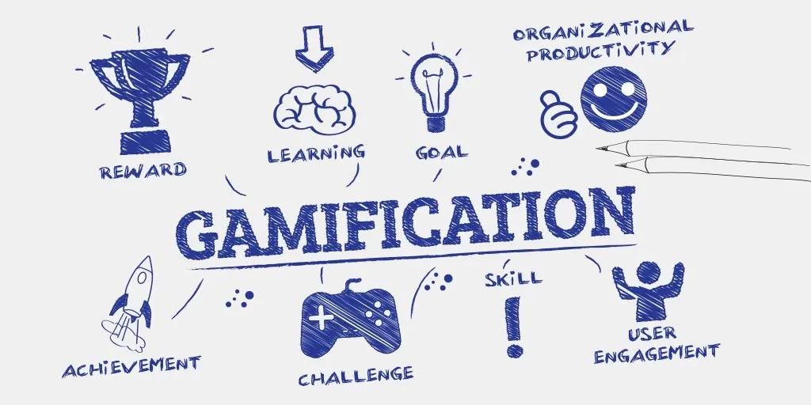
GAMIFICATION AND GAME BASED MARKETING
Gamification:
Gamification involves incorporating game-design elements and principles into non-game contexts to motivate and increase engagement. It’s used to make activities more engaging and enjoyable, which can enhance user experience and drive desired behaviors.
Game-Based Marketing:
Game-based marketing uses actual games or game-like experiences as a marketing tool to engage with audiences, promote a brand, and drive user interaction.
This can involve creating branded games or integrating marketing messages into existing games.
Benefits:
Enhanced Engagement
Increased Brand Recall
Positive Associations
Viral Potential

Slide 20

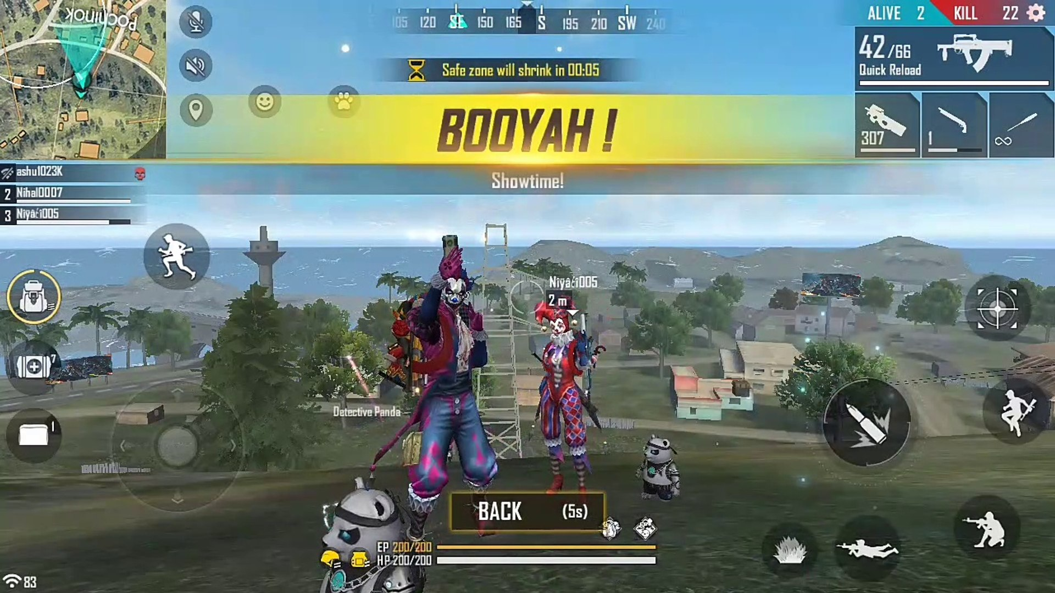

CONSUMER MOTIVATION FOR PLAYONG ONLINE GAMES
Consumer motivation for playing online games is a multifaceted topic that encompasses various psychological, social, and emotional factors.
Fun and Entertainment:
Enjoyment: People play games because they’re fun and enjoyable.
Escape: Games offer a break from everyday life and help people relax.
2. Achievement:
Challenges: Players love overcoming obstacles and solving puzzles.
Rewards: Earning points, badges, or leveling up feels satisfying.
3. Social Interaction:
Connecting: Games let players make friends and stay in touch with others.
Teamwork and Competition: People enjoy working with or against others in games.

Slide 21
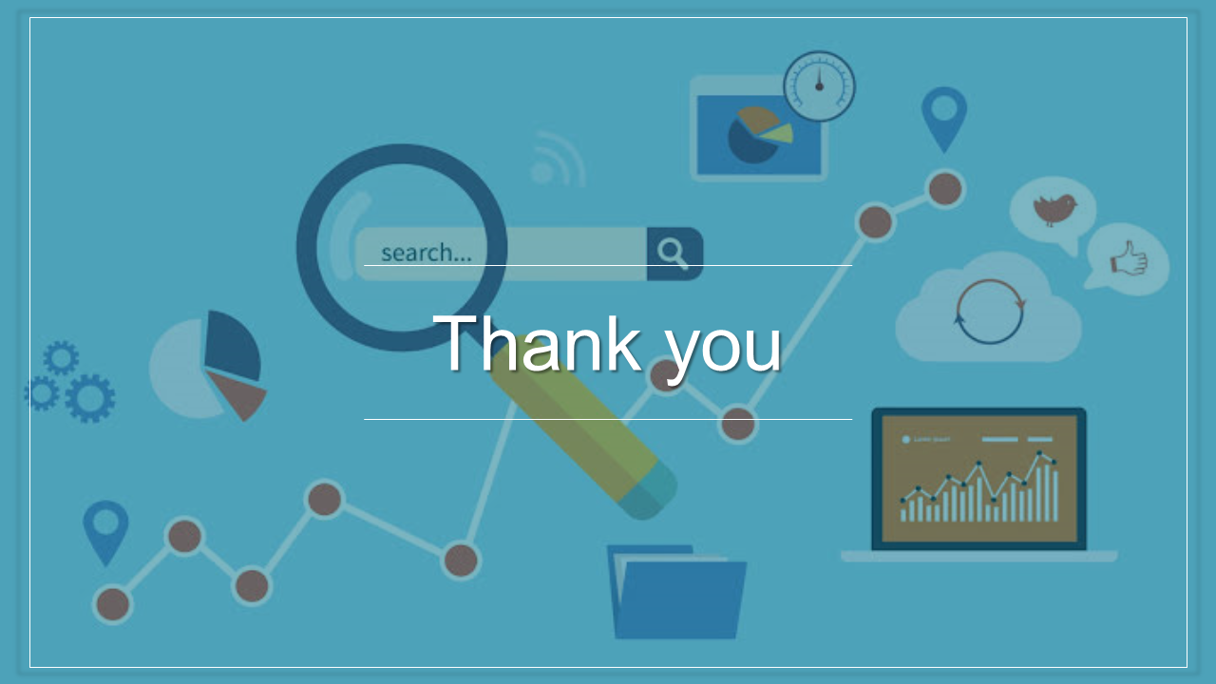


Slide 22

RESOURCE COLLECTED
CHAT GPT

